Slide 1
NT219-Cryptography
Week 09: Asymmetric Cryptography (P4)
PhD. Ngoc-Tu Nguyen
tunn@uit.edu.vn

Slide 2
Outline
Why asymmetric cryptography?
Factoring Based Cryptography (P1)
RSA
Rabin
Logarithm Based Cryptography (P2)
Elliptic Curve Cryptography (P3)
Some advanced cryptography system (quantum resistance)
Notes:
Cipher=a secret system of writing;

Slide 3
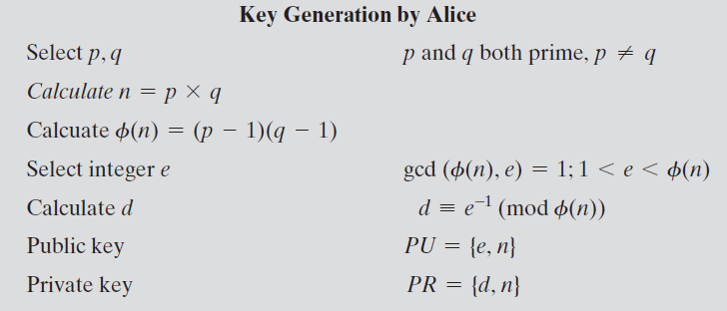
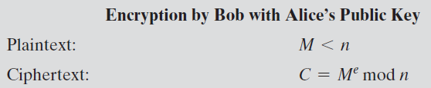
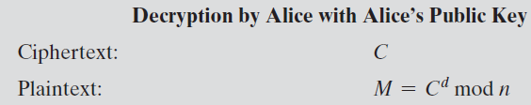


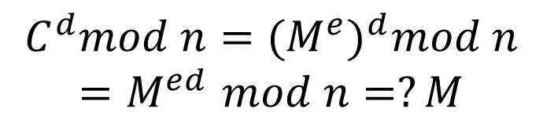
Implementation the R S A Algorithm (review)
Fermat's little theorem
λ(n) = lcm(p − 1, q − 1)
$$e.d=1 mod φ(n)$$
Carmichael's theorem
$$e.d=1 mod λ(n)$$
$$C^{d}mod n={{(M}^{e})}^{d}mod n$$
$${=M}^{ed}mod n=?M$$
Notes:
Figure 9.5 summarizes the RSA algorithm. It corresponds to Figure 9.1a: Alice
generates a public/private key pair; Bob encrypts using Alice’s public key; and Alice
decrypts using her private key.

Slide 4

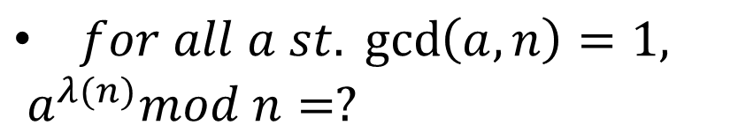

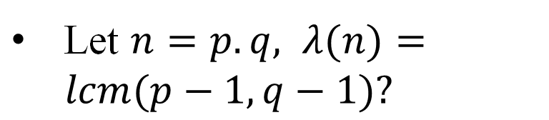
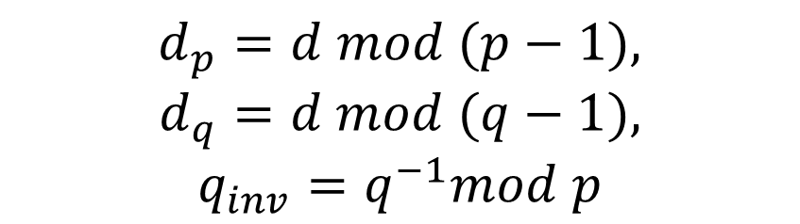
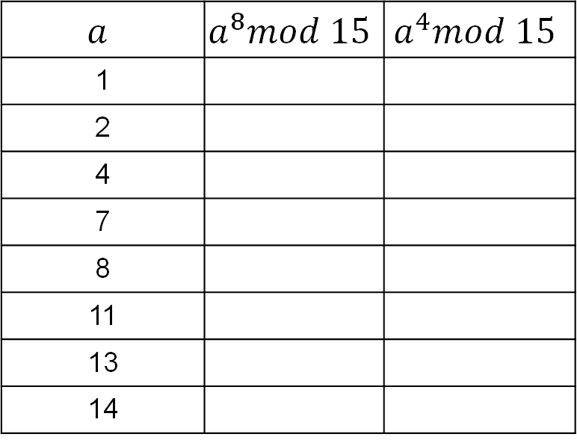

Implementation The R S A Algorithm ((review) )
Generalization of Fermat's little theorem
$$n=15,ℤ_{15}=\{0,1,2,…15\}$$
Let $n=p.q, λ(n)=lcm(p−1,q−1)?$
$$n=3.5=15, φ\left(15\right)=8,$$
$$λ\left(n\right)=lcm\left(2,4\right)=4$$
$for all a st. \gcd\left(a,n\right)=1,$
$a^{λ(n)}mod n=?$
$$a$$ | $$a^{8}mod 15$$ | $$a^{4}mod 15$$
1
2
4
7
8
11
13
14
$$PU=\{n, e\}$$
$$PR=\{n, p,q,d, d_{p},d_{q},q_{inv}\}$$
$$d_{p}=d mod (p−1),$$
$$d_{q}=d mod (q−1),$$
$$q_{inv}=q^{−1}mod p$$
 Openssl_key_geneeration.txt
Notes:
Figure 9.5 summarizes the RSA algorithm. It corresponds to Figure 9.1a: Alice
generates a public/private key pair; Bob encrypts using Alice’s public key; and Alice
decrypts using her private key.

Slide 5
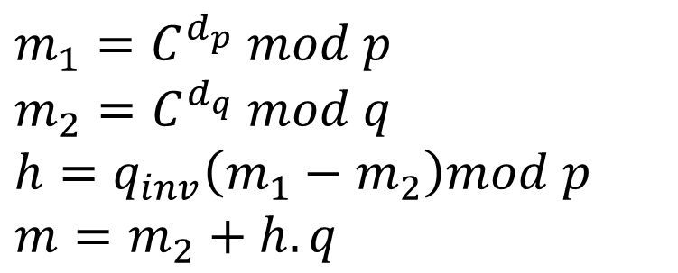

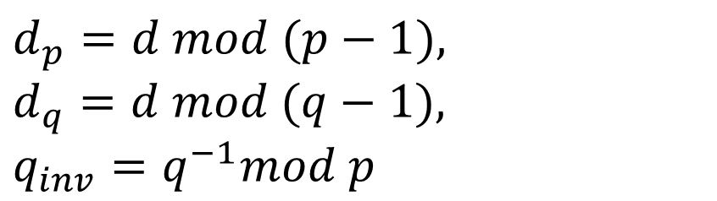


Implementation The R S A Algorithm
Encrypt
$$PU=\{n, e\}$$
$$C=m^{e}mod n$$
$$PR=\{n, p,q,d, d_{p},d_{q},q_{inv}\}$$
Decrypt
$$d_{p}=d mod (p−1),$$
$$d_{q}=d mod (q−1),$$
$$q_{inv}=q^{−1}mod p$$
$$m=C^{d}mod n !$$
$$m_{1}=C^{d_{p}} mod p$$
$$m_{2}=C^{d_{q}} mod q$$
$$h=q_{inv}\left(m_{1}−m_{2}\right)mod p$$
$$m=m_{2}+h.q$$
 Chinese remainder theorem
Notes:
Figure 9.5 summarizes the RSA algorithm. It corresponds to Figure 9.1a: Alice
generates a public/private key pair; Bob encrypts using Alice’s public key; and Alice
decrypts using her private key.

Slide 6
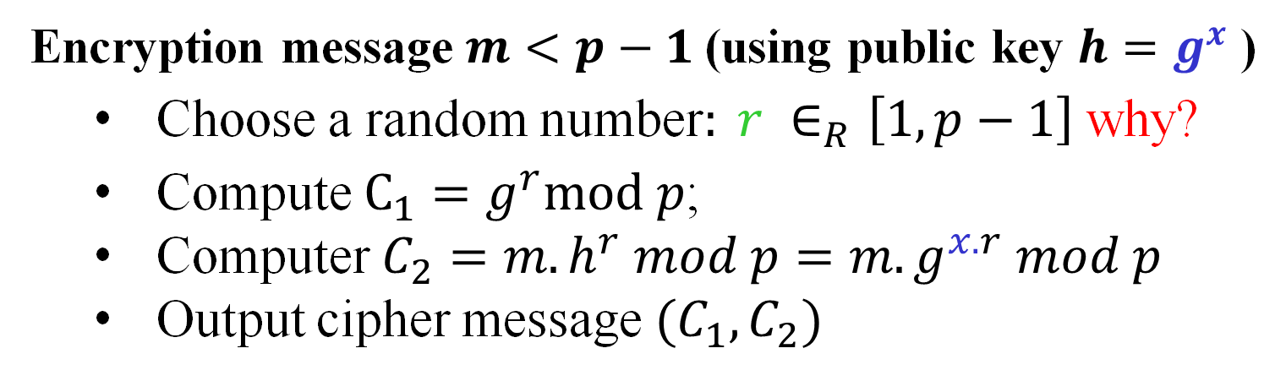
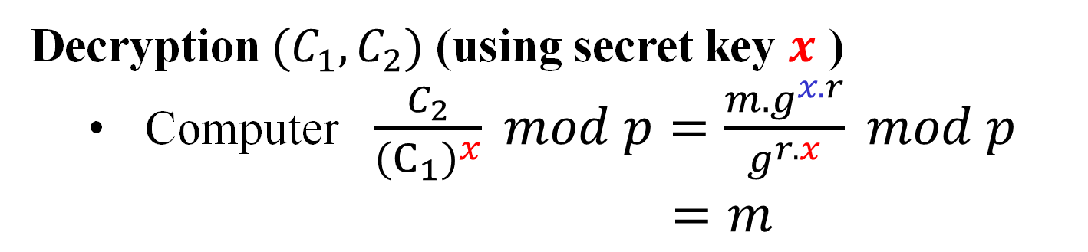
ElGamal cipher
Encryption message $m<p−1$(using public key $h=g^{x}$ )
Choose a random number$: r ∈_{R}\left[1,p−1\right]$ why?
Compute $C_{1}=g^{r}mod p$;
Computer $C_{2}=m.h^{r} mod p=m.g^{x.r} mod p$
Output cipher message $(C_{1},C_{2})$
Decryption $(C_{1},C_{2})$ (using secret key $x$ )
Computer $\frac{C_{2}}{{\left(C_{1}\right)}^{x}} mod p=\frac{m.g^{x.r}}{g^{r.x}} mod p$
$=m$

Slide 7
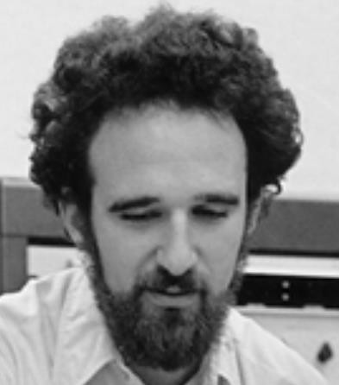
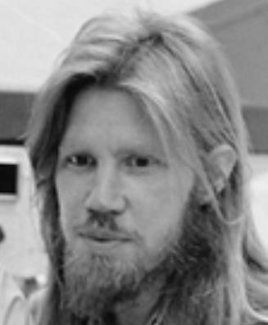


Diffie-Hellman exchange Protocol (DHE)
p = 1606938044258990275541962092341162602522202993782792835301301
𝑔 = 123456789
𝑔^{𝑎} mod p = 78467374529422653579754596319852702575499692980085777948593
𝑔^{𝑏} mod p =
560048104293218128667441021342483133802626271394299410128798
𝑎 =
685408003627063
761059275919665
781694368639459
527871881531452
𝑏 =
362059131912941
987637880257325
269696682836735
524942246807440
𝑔^{𝑎𝑏} mod p = 437452857085801785219961443000845969831329749878767465041215
${{(g}^{b})}^{a}$ $mod p$
$${{(g}^{a})}^{b}mod p$$

Slide 8
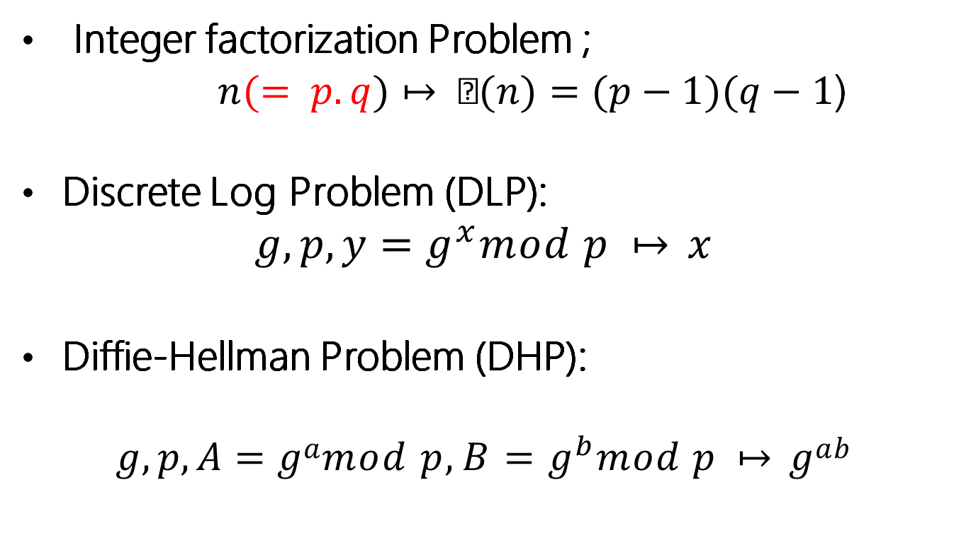
Computational hardness assumptions
Integer factorization Problem ;
$n(= p.q)↦ (n)=(p−1)(q−1$)
Discrete Log Problem (DLP):
$$g, p,y=g^{x}mod p ↦ x$$
Diffie-Hellman Problem (DHP):
$$g,p, A=gamod p, B=g^{b}mod p ↦ gab$$

Slide 9










Man-in-the middle attacks the DHE
$$g^{a} mod p$$
$$(a,g^{a})$$
$$(b,g^{b})$$
$$g^{b} mod p$$
$$sk={{(g}^{b})}^{a}={{(g}^{a})}^{b}=g^{ab}mod p$$
B(Zelensky)
A(Putin)
man-in-the-middle attack!
$$g^{m} mod p$$
$$g^{a} mod p$$
$$g^{m} mod p$$
$$g^{b} mod p$$
$$sk_{1}=g^{am}mod p$$
$$sk_{2}=g^{bm}mod p$$

Slide 10
Group (G,+)
Ring (R, +, ×)
Motivations
can do + −
lightweight computational overhead?
can do + − ×
can do + − × ÷
Field
(F, +, ×)

Slide 11
Elliptic curve
An el iptic curve is a group defined over a field K
elliptic curve group (𝐸,⊕) underlying field (𝐾, +, ×)
can do ⊕ ⊖
can do + − × ÷
operations in underlying field are used and combined to compute the el iptic curve operation ⊕

Slide 12

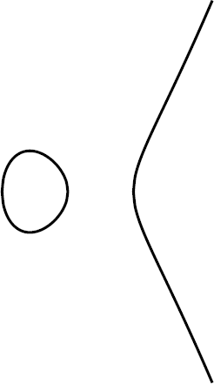
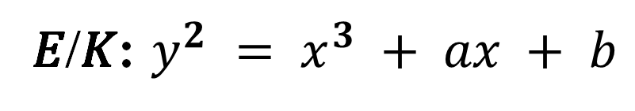
Elliptic curves
Weierstrass form
𝐸 specified by 𝐾, 𝑎, 𝑏
𝐸/𝐾: $y^{2} = x^{3} + ax + b$
𝐸/ℝ : 𝑦² = 𝑥³ + 𝑥 + 1
𝐸/ℝ : 𝑦² = 𝑥³ − 𝑥

Slide 13
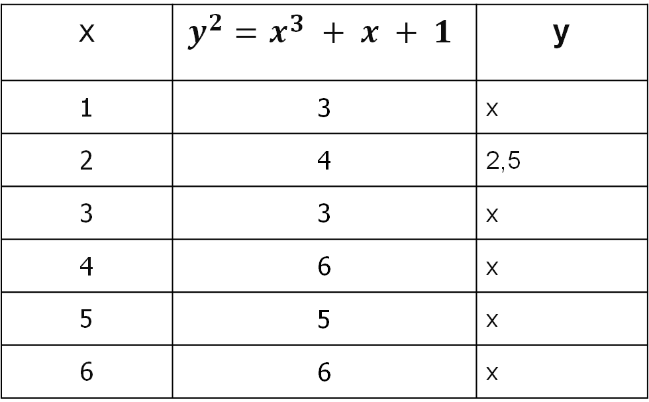

Elliptic curves
Weierstrass form
𝐸/ℝ : 𝑦² = 𝑥³ + 𝑥 + 1
$$E /ℤ_{7} : y2 = x3 + x + 1(mod 7)$$
x | $$y^{2}=x3 + x + 1$$ | y
1 | 3 | x
2 | 4 | 2,5
3 | 3 | x
4 | 6 | x
5 | 5 | x
6 | 6 | x

Slide 14
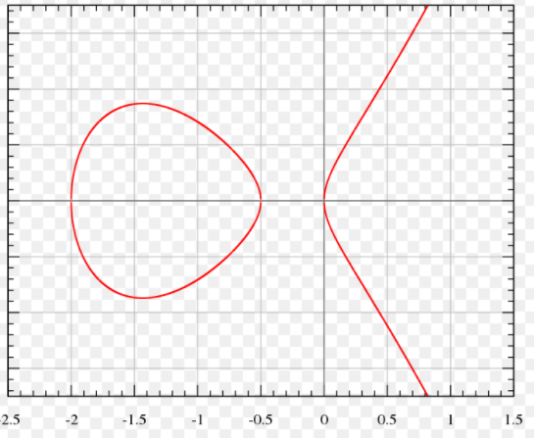
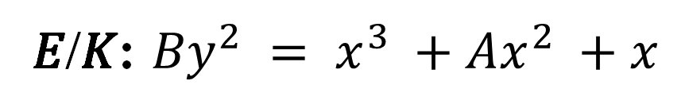
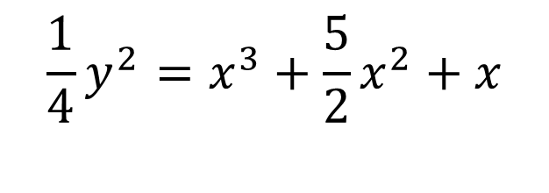
Elliptic curves
Montgomery form
𝐸/𝐾: ${By}^{2} = x^{3} +Ax^{2} +x$
𝐸 specified by 𝐾, A, B
𝐸/ℝ :
$$\frac{1}{4}y^{2}=x^{3}+\frac{5}{2}x^{2}+x$$

Slide 15
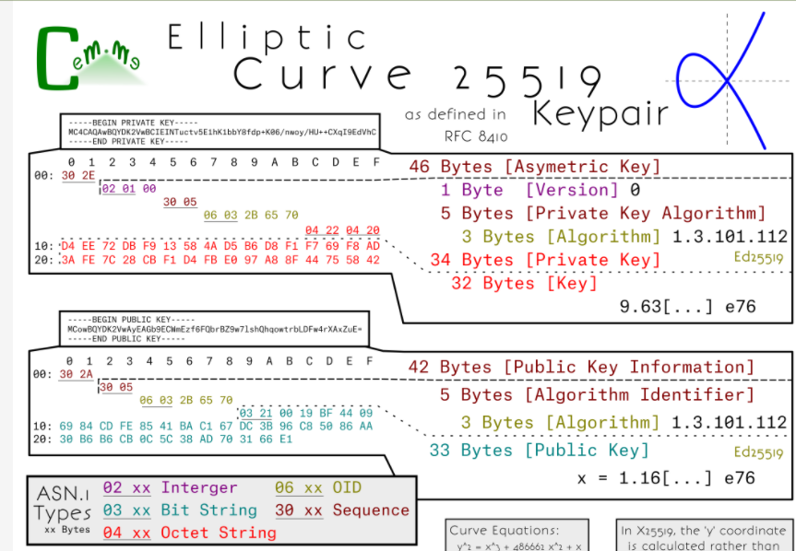
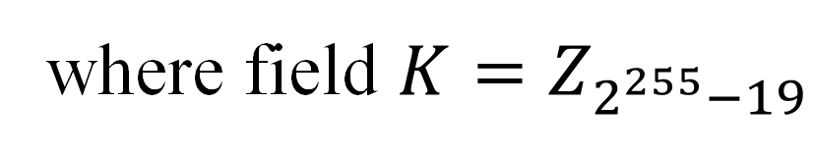
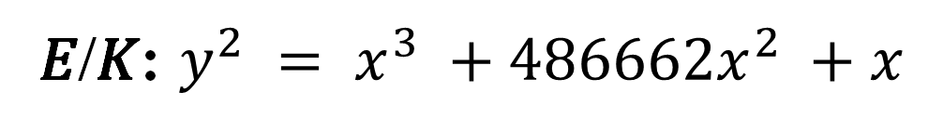
Curve25519
𝐸/𝐾: $y^{2} = x^{3} +486662x^{2} +x$
where field $K=Z_{2^{255}−19}$

Slide 16
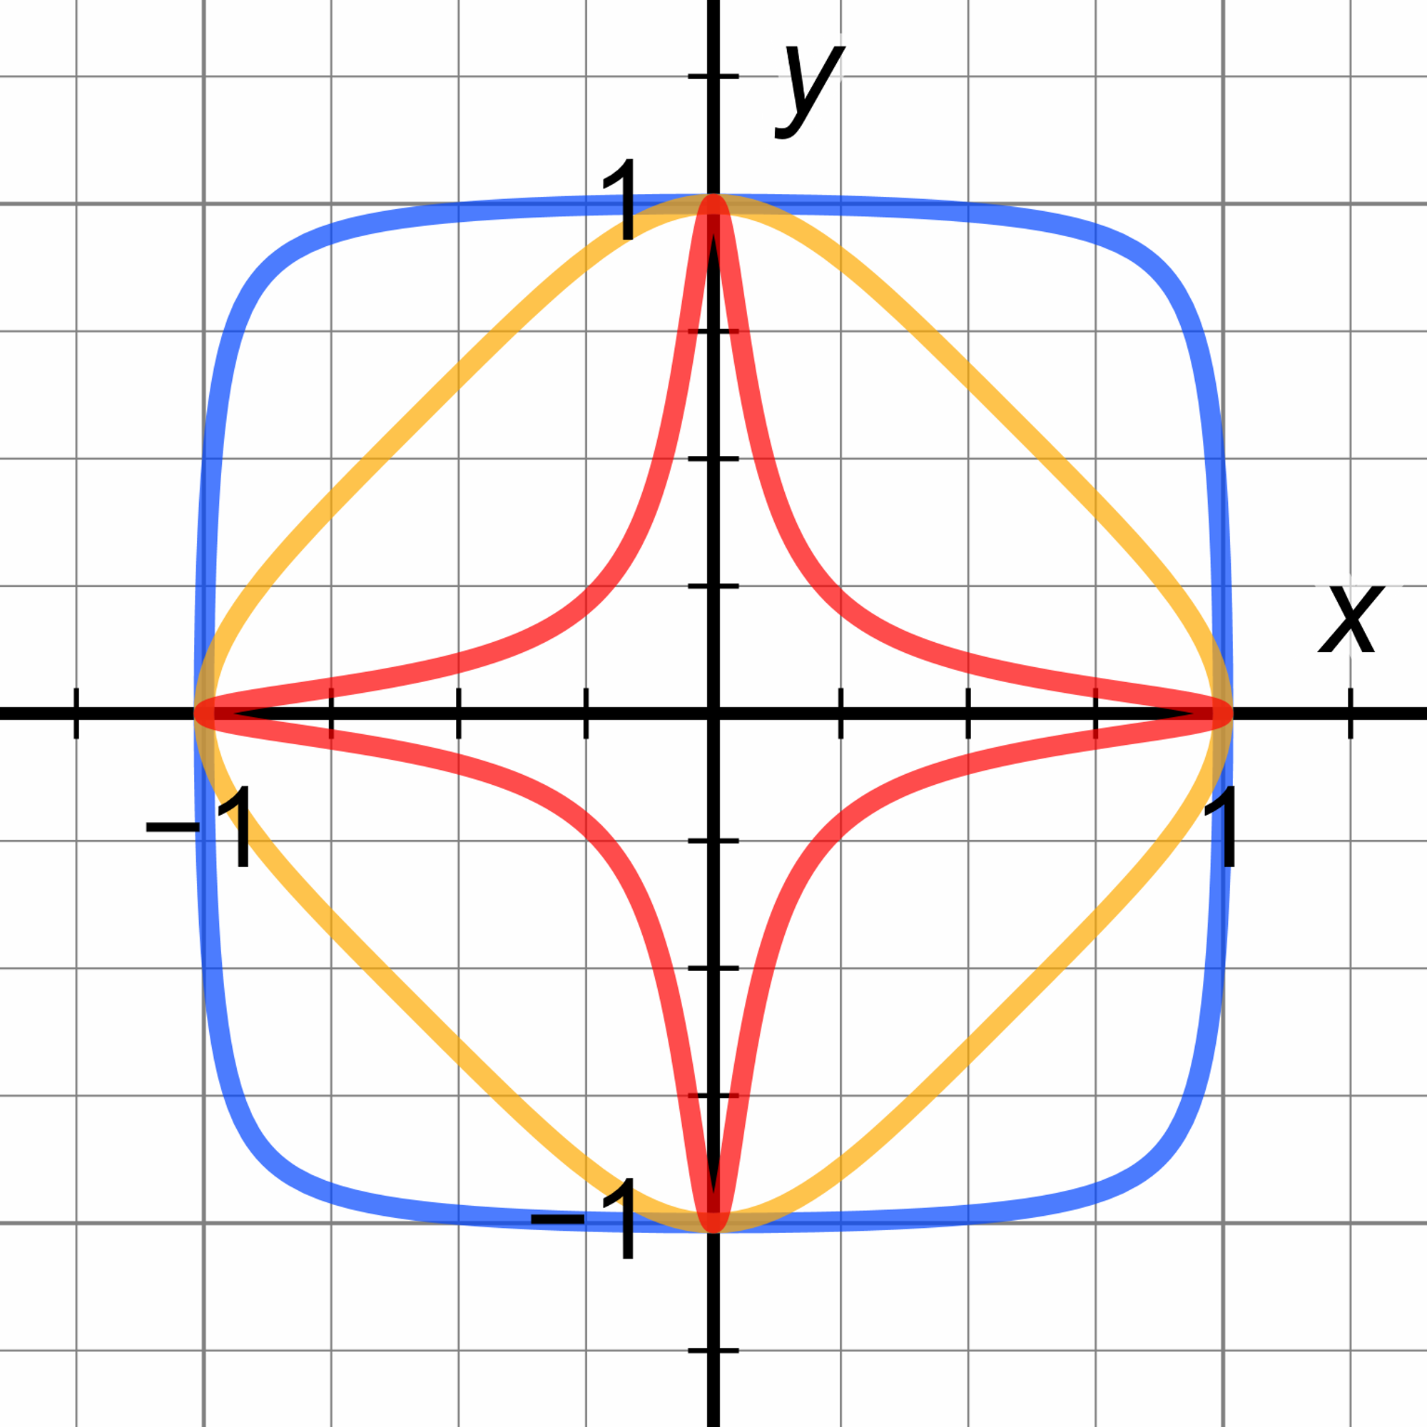

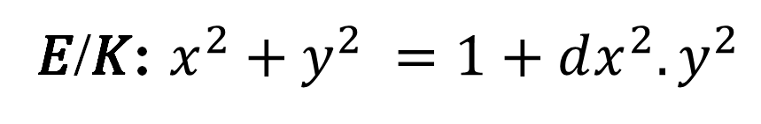
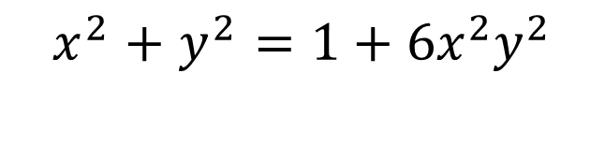
Elliptic curves
Edwards form (Ed)
𝐸/𝐾: $x^{2}+y^{2} =1+dx^{2}.y^{2}$
𝐸 specified by: 𝐾, d
𝐸/ℝ :
$$x^{2}+y^{2}=1+6x^{2}y^{2}$$
https://safecurves.cr.yp.to/

Slide 17
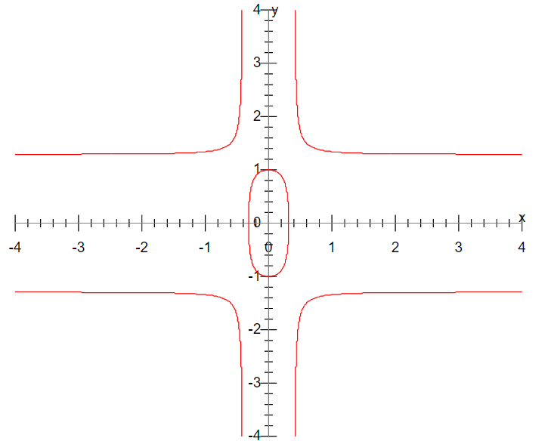
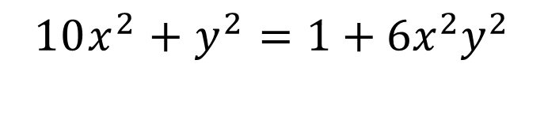
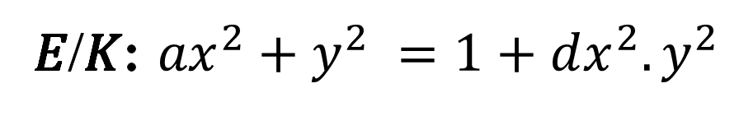
Elliptic curves
Twisted Edwards form
𝐸/𝐾: ${ax}^{2}+y^{2} =1+dx^{2}.y^{2}$
𝐸 specified by: 𝐾, a, d
𝐸/ℝ :
$$10x^{2}+y^{2}=1+6x^{2}y^{2}$$
https://safecurves.cr.yp.to/

Slide 18
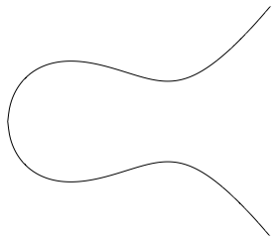
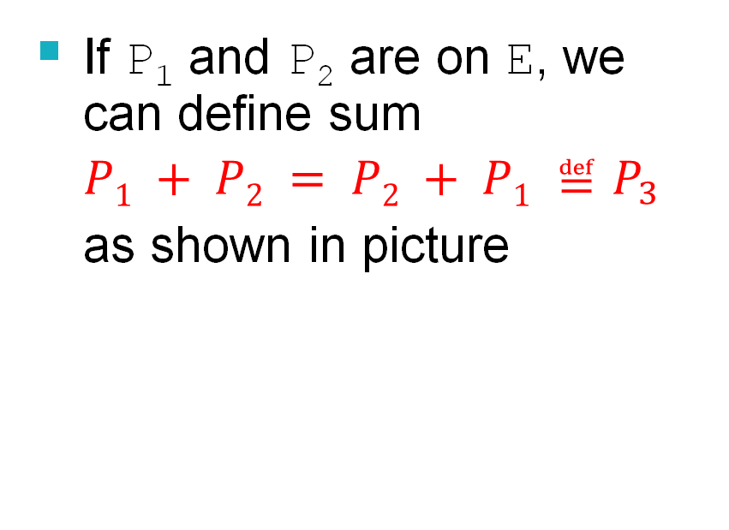
Elliptic group
Addition of two points:
y
If P₁ and P₂ are on E, we can define sum
$P1 + P2 = P2 + P1 ≝P_{3}$
as shown in picture
P₂
P₁
x
P₃

Slide 19
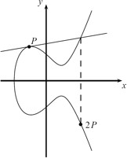
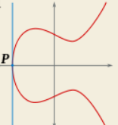
Elliptic group
Point Doubling
Special case
=P+P
P+P= O (infinity)

Slide 20
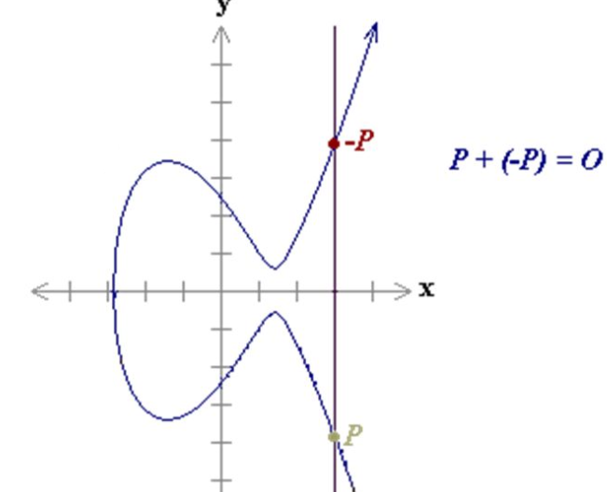
Elliptic group
P+ O = P
O + P = P
P+(-P)= O (infinity)

Slide 21
Elliptic group
Example

Slide 22
Elliptic group
Given two points P, Q in E/K, there is a third point, denoted by P + Q on E/K, and the following relations hold for all P, Q, R in E/K, where K be a finite field
P + Q = Q + P (commutativity)
(P + Q) + R = P + (Q + R) (associativity)
P + O = O + P = P (existence of an identity element)
there exists ( − P) such that − P + P = P + ( − P) = O (existence of inverses)

Slide 23

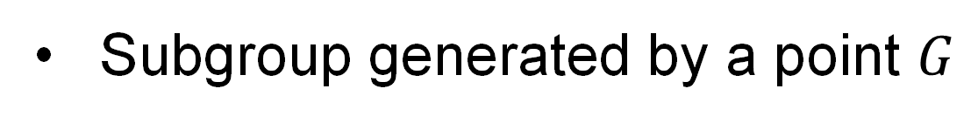


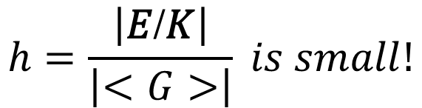



Elliptic group
Group points 𝐸/𝐾
Subgroup generated by a point $G$
$$<G>=\{G,2G,….,kG,…\}=\{kG:k∈K \} ⊂ E/K$$
$$G$$
$$G$$
$$n=\left|<G>\right|=|\left\{kG:k∈K \right\}|$$
$$3G$$
•
•
$$5G$$
$$h=\frac{\left|\text{E}\text{/}\text{K}\right|}{\left|<G>\right|} is small!$$
•
$$4G$$
•
$$6G$$
$$2G$$
•

Slide 24

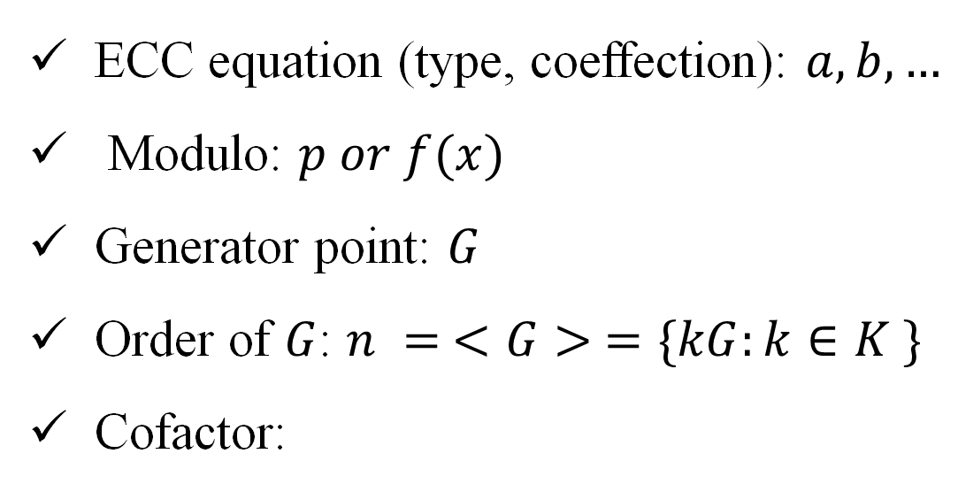






Elliptic group
ECC group parameters:
ECC equation (type, coeffection): $a, b,…$
Modulo: $p or f(x)$
Generator point: $G$
Order of $G$: $n = <G> =\{kG:k∈K \}$
Cofactor:
$$<G> =\{kG:k∈K \} ⊂ E/K$$
$$G$$
$$G$$
$$3G$$
•
•
$$5G$$
$$h=\frac{\left|\text{E}\text{/}\text{K}\right|}{\left|<G>\right|}$$
•
$$4G$$
•
$$6G$$
$$2G$$
http://www.secg.org/sec2-v2.pdf
•

Slide 25
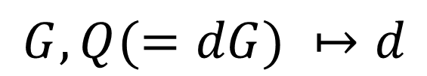

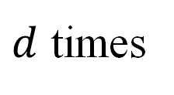
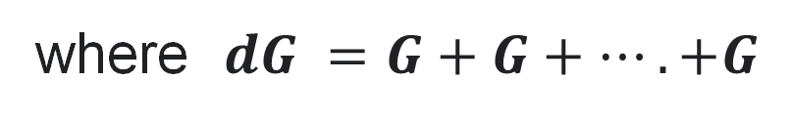
Using Elliptic Curves In Cryptography
Hardness assumption.
Elliptic curve discrete logarithm problem (ECDLP)
Discrete Log Problem (DLP):
$$g, p, y=g^{x}mod p ⟼x$$
$$G, Q(=dG) ↦d$$
where $dG =G+G+….+G$
$d$ times

Slide 26
Elliptic Curve Cryptosystems (ECC)
Algorithm | Encryption/Decryption | Digital Signature | Key Exchange
RSA | Yes | Yes | Yes
Elliptic Curve | Yes | Yes | Yes
Diffie–Hellman | No | No | Yes
DSS | No | Yes | No

Slide 27
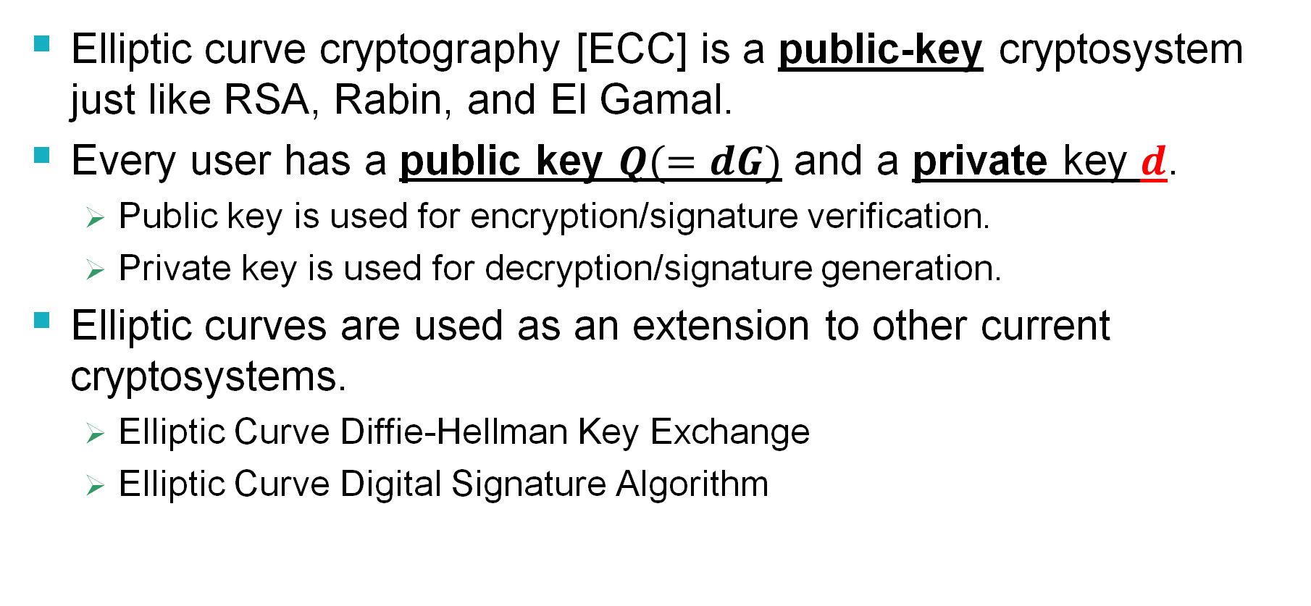
What Is ECC?
Elliptic curve cryptography [ECC] is a public-key cryptosystem just like RSA, Rabin, and El Gamal.
Every user has a public key $Q(=dG)$ and a private key $d$.
Public key is used for encryption/signature verification.
Private key is used for decryption/signature generation.
Elliptic curves are used as an extension to other current cryptosystems.
Elliptic Curve Diffie-Hellman Key Exchange
Elliptic Curve Digital Signature Algorithm

Slide 28
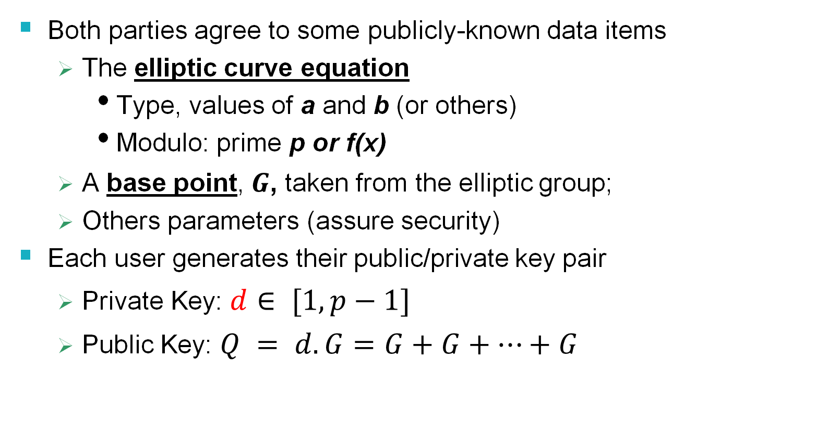
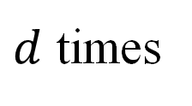
Generic Procedures of ECC
Both parties agree to some publicly-known data items
The elliptic curve equation
Type, values of a and b (or others)
Modulo: prime p or f(x)
A base point,$G$, taken from the elliptic group;
Others parameters (assure security)
Each user generates their public/private key pair
Private Key:$d∈ [1, p−1]$
Public Key: $Q = d.G=G+G+…+G$
$d$ times

Slide 29
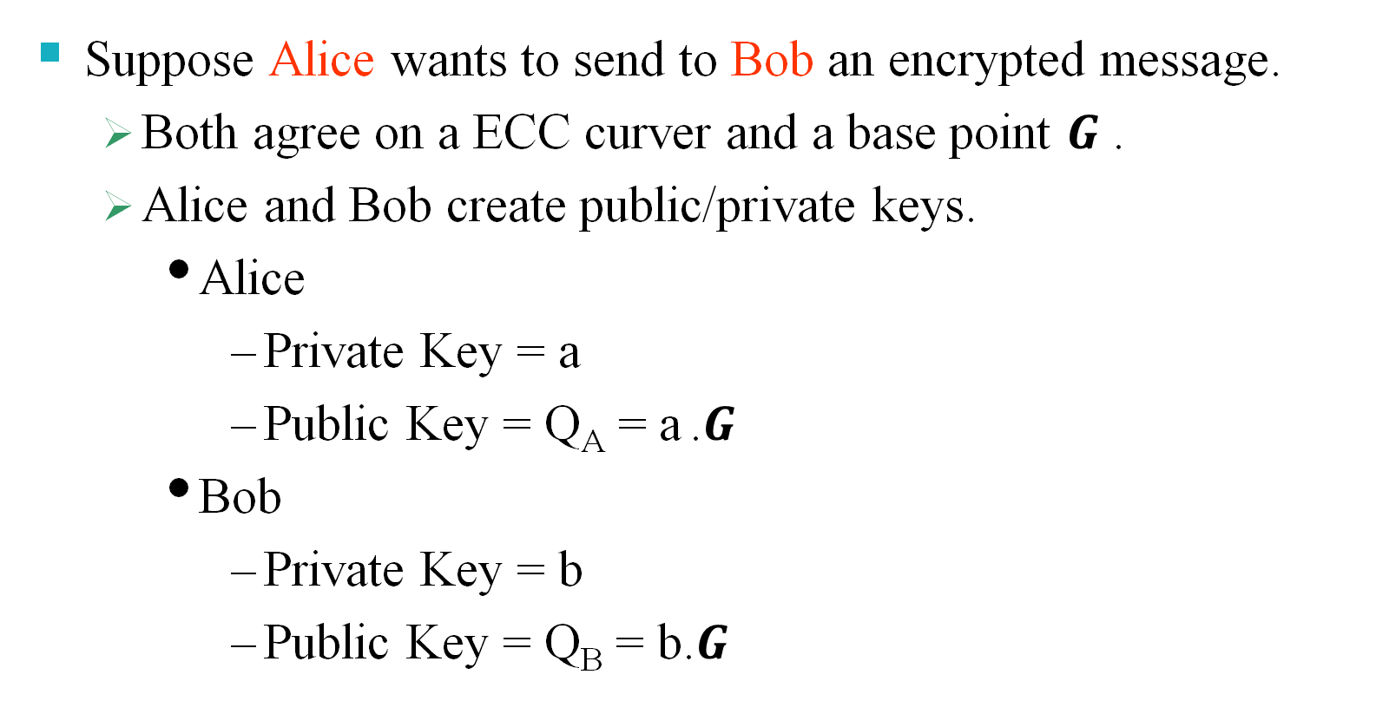
ECC Cipher
Suppose Alice wants to send to Bob an encrypted message.
Both agree on a ECC curver and a base point $G$ .
Alice and Bob create public/private keys.
Alice
Private Key = a
Public Key = Q_{A} = a .$G$
Bob
Private Key = b
Public Key = Q_{B} = b.$G$

Slide 30


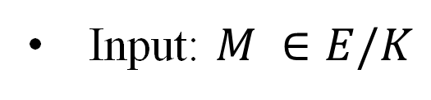

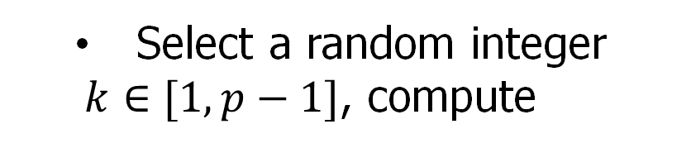
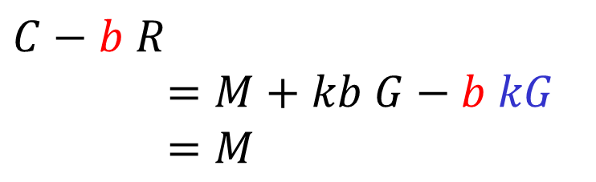
ECC Cipher
Alice
public key
Bob
public key
?
public key
private key
$$(G,PK_{B}=bG,SK=b)$$
Input: $M ∈E/K$
Select a random integer
$k∈[1, p−1]$, compute
Decrypt
Encrypt
$$(R,C)$$
$$C−b R$$
$$=M+kb G−b kG$$
$$=M$$
$$R=kG, C=M+k .PK_{B}$$

Slide 31
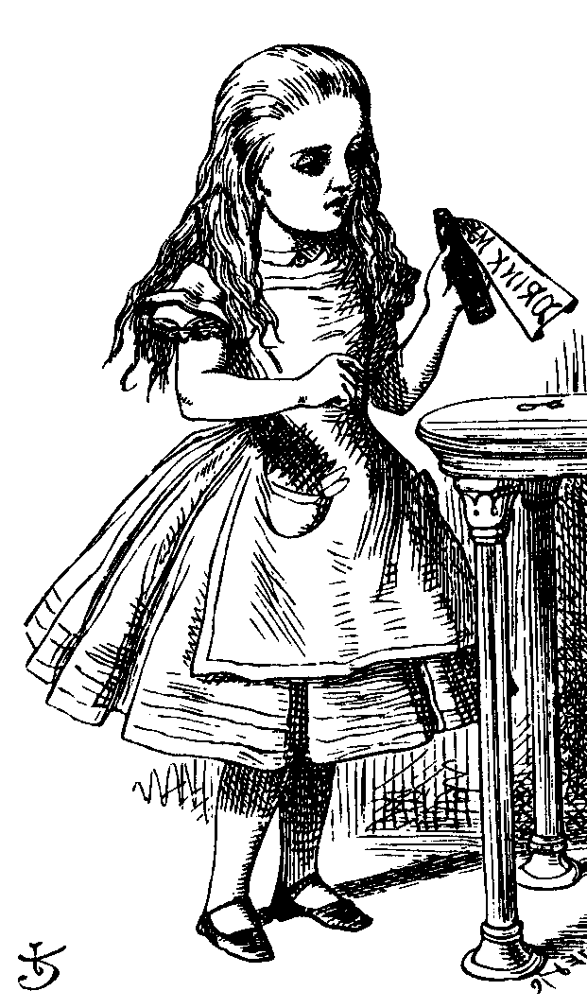







ECC Diffie-Hellman (ECDHE)
Public: Elliptic curve and a point $G$=(x,y) on curve
Secret: Alice’s a and Bob’s b
$(a{, Q}_{A})$
$(b{, Q}_{B})$
$$Q_{A}(=a.G)$$
$Q_{B}(=b.G$)
Alice, A
Bob, B
Alice computes $K_{A}=a.Q_{B}=ab.G$
Bob computes $K_{B}=b.Q_{A}=ba.G$
These are the same since $K_{A}=K_{B}=ab G$

Slide 32
Diffie-Hellman key exchange attack
$$g^{a} mod p$$
$$(a,g^{a})$$
$$(b,g^{b})$$
$$g^{b} mod p$$
$$sk={{(g}^{b})}^{a}={{(g}^{a})}^{b}=g^{ab}mod p$$
Bob
Alice
man-in-the-middle attack!
$$g^{m} mod p$$
$$g^{a} mod p$$
$$g^{m} mod p$$
$$g^{b} mod p$$
$$sk_{1}=g^{am}mod p$$
$$sk_{2}=g^{bm}mod p$$

Slide 33














Diffie-Hellman key exchange attack
$$Q_{A}$$
$$(a,Q_{A}=aG)$$
$$Q_{B}$$
$$(b,Q_{B}=bG)$$
$$sk=aQ_{B}=bQ_{A}=abG$$
Bob
Alice
man-in-the-middle attack!
$$mG$$
$$aG$$
$$mG$$
$$bG$$
$$(a,Q_{A}=aG)$$
$$(b,Q_{B}=bG)$$
$$sk_{1}=amG$$
$$(m,Q_{M}=mG)$$
$$sk_{2}=bmG$$

Slide 34
Why use ECC?
How do we analyze Cryptosystems?
How difficult is the underlying problem that it is based upon
RSA – Integer Factorization
DH – Discrete Logarithms
ECC - Elliptic Curve Discrete Logarithm problem
How do we measure difficulty?
We examine the algorithms used to solve these problems

Slide 35
Security of ECC
To protect a 128 bit AES key it would take a:
RSA Key Size: 3072 bits
ECC Key Size: 256 bits
How do we strengthen RSA?
Increase the key length
Impractical?
Symmetric Encryption (Key Size in bits) | RSA and Diffie-Hellman (modulus size in bits) | ECC Key Size in bits
56 | 512 | 112
80 | 1024 | 160
112 | 2048 | 224
128 | 3072 | 256
192 | 7680 | 384
256 | 15360 | 512
3
https://nvlpubs.nist.gov/nistpubs/SpecialPublications/NIST.SP.800-57pt1r5.pdf
4
5

Slide 36
Applications of ECC
Many devices are small and have limited storage and computational power
Where can we apply ECC?
Wireless communication devices
Smart cards
Web servers that need to handle many encryption sessions
Any application where security is needed but lacks the power, storage and computational power that is necessary for our current cryptosystems

Slide 37
Benefits of ECC
Same benefits of the other cryptosystems: confidentiality, integrity, authentication and non-repudiation but…
Shorter key lengths
Encryption, Decryption and Signature Verification speed up
Storage and bandwidth savings

Slide 38
Summary of ECC
“Hard problem” analogous to discrete log
Q=kG, where Q,G belong to a prime curve
given k,G → “easy” to compute Q
given Q,G → “hard” to find k
known as the elliptic curve logarithm problem
k must be large enough
ECC security relies on elliptic curve logarithm problem
compared to factoring, can use much smaller key sizes than with RSA etc
for similar security ECC offers significant
computational advantages

